Slide 2
INVENTORY MANAGEMENT (MINIPROJECT 1)
PRESENTED BY:
ANTHONY BERNARD CERENO
KRISTINE OSEA

Slide 3
BACKGROUND OF THE PROJECT
In these challenging times, people are constantly looking for ways to improve their lives and increase their income. As the saying goes, "If you want to become a scientist, learn from scientists. But if you want to become a millionaire, learn from millionaires." -Anonymous. Entrepreneurship is a great way to do this, and many people start by running a business while also working full-time. However, this can be stressful and time-consuming, and it can be difficult to keep track of everything while you're away from your business.
But with our inventory management system, you can stay in control of your business no matter where you are. Imagine being able to check your phone and with just a few clicks, you can notify your staff and stay informed about what's happening in your business. For those who are serious about becoming wealthy, Time is Money And with our inventory management system, you'll save both.

Slide 4
Statement of the Problem
1. How to prevent in demand product from running out of stock?
2. How minimize overstock product?
3. How to avoid losing sales due to expiry or expired product.
4. How to choose better supplier amongst existing one?
5. How to minimize stolen goods?

Slide 5
Project Solution
Compare product performance from past and present
Provide alerts when items are low
Identify items that are hard to sell
Provide detailed reports and Analytic
Only authorized persons set by owner will access the inventory/warehouse

Slide 6
System Features
A. User Management
B. Inventory Tracking
C. Order Management
D. Real-time Reporting and Analytics
E. Notifications
F. Staff Management
G. Product Management

Slide 7


Limitations
1. Limited to only tracking in/out items in the warehouse/inventory
2. Dependent on internet connectivity
3. Requires physical device/smartphone for all staff members
4. May have compatibility issues with different devices and operating systems
5. Security concerns such as data privacy and hacking risks
6. Possible downtime due to technical issues or maintenance needs
7. Potential limitations in scalability as the business grows
8. Limited customization options
THEME:
FONTS: INTER, 64, 24, 16, 12
LOGO:
Technology used:
HTML 5, CSS 3, BOOTSTRAP, FIGMA.COM, CANVA.COM, LOGO.COM.

Slide 8
Theme, Fonts, logo, Technology used
:
THEME:
FONTS: INTER, 64, 24, 16, 12
LOGO:
Technology used:
HTML 5, CSS 3, BOOTSTRAP, FIGMA.COM, CANVA.COM, LOGO.COM.

Slide 9
SITE MAP
ADD PRODUCT
STAFFS
STORE
MAINTENANCE
SUPPLIERS
ORDERS
SETTINGS
LOGIN
LANDING PAGE
URL
SIGN-UP

Slide 10
SITE MAP
URL
LANDING PAGE
SIGN-UP
LOGIN
STORE
ADD PRODUCT
ORDERS
STAFFS
SUPPLIERS
SETTINGS
MAINTENANCE

Slide 11
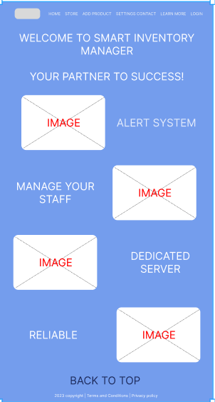

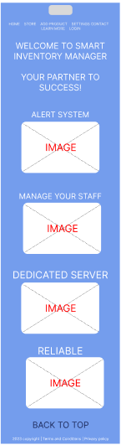
LANDING PAGE
WIREFRAME

Slide 12
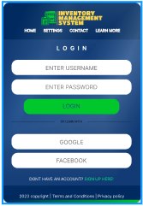
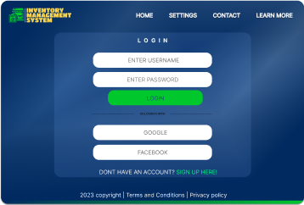
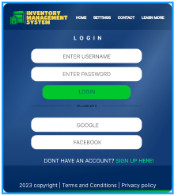
LANDING PAGE
DESKTOP
TABLET
SMARTPHONE

Slide 13
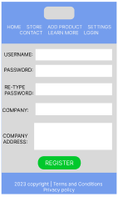
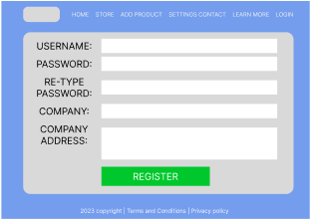
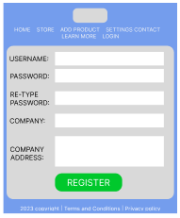
SIGN IN
DESKTOP
TABLET
SMARTPHONE

Slide 14
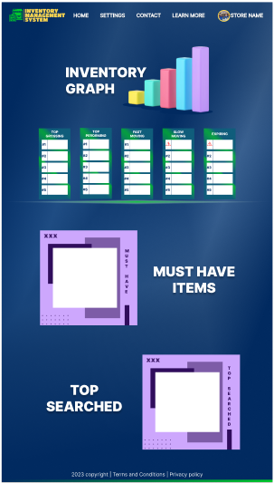
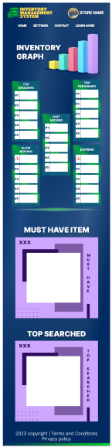
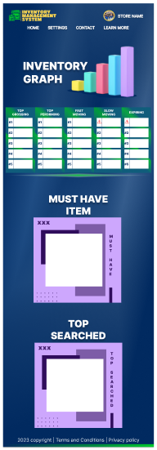
SIGN UP
DESKTOP
TABLET
SMARTPHONE

Slide 15
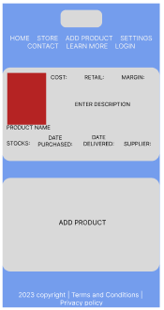
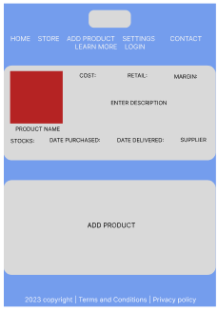
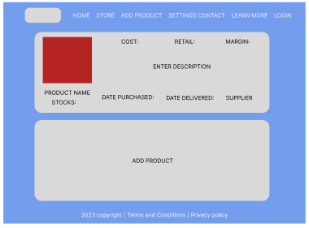
STORE
SMARTPHONE
TABLET
DESKTOP

Slide 16
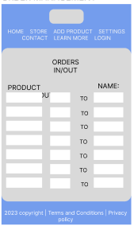
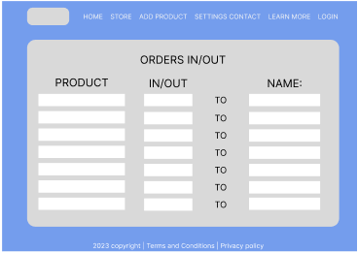
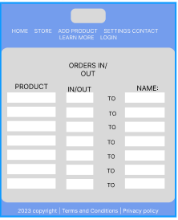
ADD PRODUCT
TABLET
SMARTPHONE
DESKTOP

Slide 17
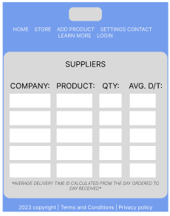
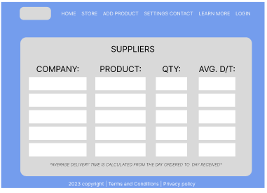
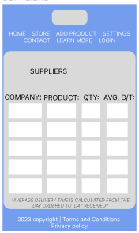
ORDER MANAGEMENT
TABLET
SMARTPHONE
DESKTOP

Slide 18
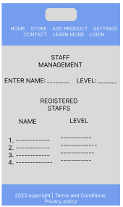
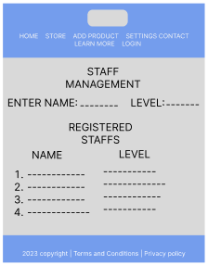
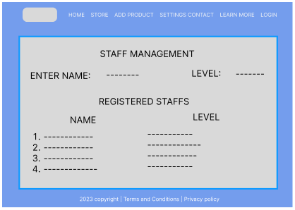
SUPPLIERS
DESKTOP
TABLET
SMARTPHONE

Slide 19
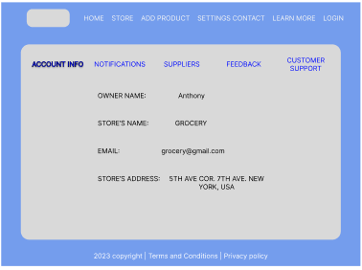
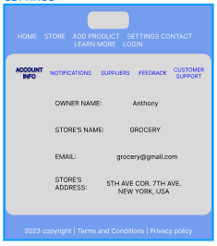
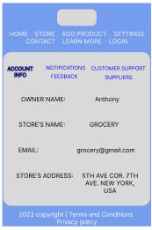
STAFF MANAGMENT
DESKTOP
TABLET
SMARTPHONE

Slide 20
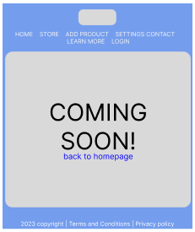
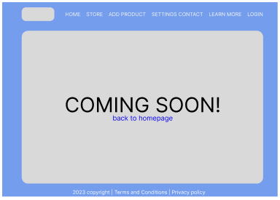

SETTINGS
DESKTOP
TABLET
SMARTPHONE

Slide 21
MAINTENANCE
DESKTOP
TABLET
SMARTPHONE

